Slide 1
Updated
 | multicate | CausalMetaR | metacart | personalized
Overview | Estimates the CATE across multiple studies using machine learning techniques and predicts the CATE in a target population of interest | Provides robust and efficient methods for Causally Interpretable Meta-Analysis – estimating causal effects in a target population using a multi-source dataset | Integrates classification and regression trees (CART) into meta-analysis to identify interaction effects between moderators | Provides functions for fitting and validation of models for subgroup identification and personalized medicine / precision medicine
Specifically for Clinical data? | ✅ | ✅
Multiple Studies/sources? | ✅ | ✅ | ✅
Multiple aggregation methods? | ✅
Multiple estimation methods? | ✅ |  |  | ✅
Heterogeneity? | ✅ | ✅ | ✅ | ✅
Individual data (IPD)? | ✅ | ✅ |  | ✅
Estimation of CATE? | ✅ | ✅ | ✅ | ✅
Prediction of CATE? | ✅ | ✅ | ✅ | ✅
To include: something about machine learning methods? More about the visuals/interpretability?

Slide 2
Aggregation Methods
Pooling with Trial Indicator [Brantner et al., 2024]: Pool all data together but keep study as an indicator and include that as a covariate in the single-study approaches
Trial 1
Fit single-study method
Pooled data with trial membership
Trial 2
…
Trial K

Slide 3
Aggregation Methods
Ensemble Forest [Tan et al., 2023]: Fit model within each study, apply each model to all individuals, and then fit an ensemble random forest to the augmented data
Trial 1
Fit ensemble model
Augmented data with K predictions per person
Trial 2
Predict according to trial 1, trial 2, …, trial K models
Fit single-study method
…
Trial K

Slide 4
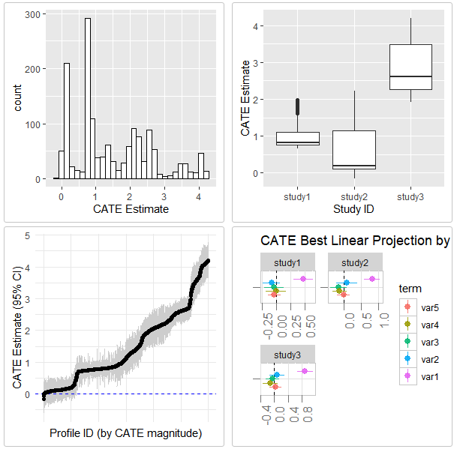
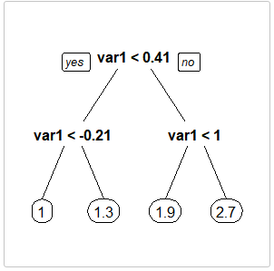
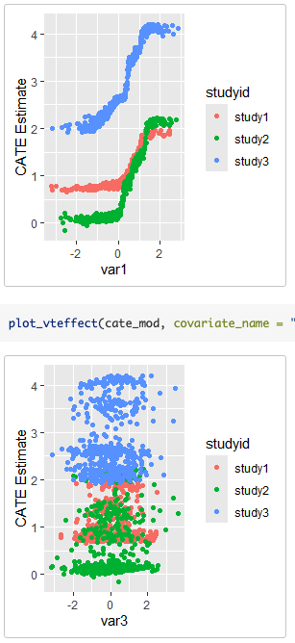
Histogram of Estiamted CATEs
Boxplot of CATEs by Study ID
95% CI Plot for All CATEs
Interpretation Tree
Best Linear Projection
Covariate Distribution by Study ID

Slide 5
 | multicate | CausalMetaR | metacart | personalized
Overview | Estimates the CATE across multiple studies using machine learning techniques and predicts the CATE in a target population of interest | Provides robust and efficient methods for Causally Interpretable Meta-Analysis – estimating causal effects in a target population using a multi-source dataset | Integrates classification and regression trees (CART) into meta-analysis to identify interaction effects between moderators | Provides functions for fitting and validation of models for subgroup identification and personalized medicine / precision medicine
Specifically for Clinical data? | ✅ | ✅
Multiple Studies/sources? | ✅ | ✅ | ✅
Heterogeneity? | ✅ | ✅ | ✅ | ✅
Individual data (IPD)? | ✅ | ✅ | ✅
Estimation of CATE? | ✅ |  | ✅
Prediction of CATE? | ✅ |  | ✅ | ✅
To include: something about machine learning methods? More about the visuals/interpretability?

Slide 6
 | multicate | CausalMetaR | metacart | personalized
Title | Estimates the CATE across multiple studies using machine learning techniques and predicts the CATE in a target population of interest | Provides robust and efficient methods for Causally Interpretable Meta-Analysis – estimating causal effects in a target population using a multi-source dataset | Integrates classification and regression trees (CART) into meta-analysis to identify interaction effects between moderators | Provides functions for fitting and validation of models for subgroup identification and personalized medicine / precision medicine
Description | Focusing on various combination of aggregation and estimation method for multiple studies and a target population, as well as visualization of covariate distributions across studies | Focusing on SATE (or PATE) using machine learning | Focusing on indentifying the interaction effects between influential moderators in meta-analysis | For subgroup identification under the general subgroup identification framework
Specifically for Clinical data? | ✅ | ✅
Multiple Studies/sources? | ✅ | ✅ |  | ✅
Heterogeneity? | ✅ | ✅
Individual traits (IPD)? | ✅ | ✅ | ✅
Estimation of CATE? | ✅ |  | ✅
Prediction of CATE? | ✅ |  | ✅ | ✅

Slide 7
Training data
Multiple studies comparing treatment efficacy
Target population
Group of patients at baseline in a health care system
Data
Step 1
Estimate CATE in studies
Step 2
Predict CATE in target population
Approach

Slide 8
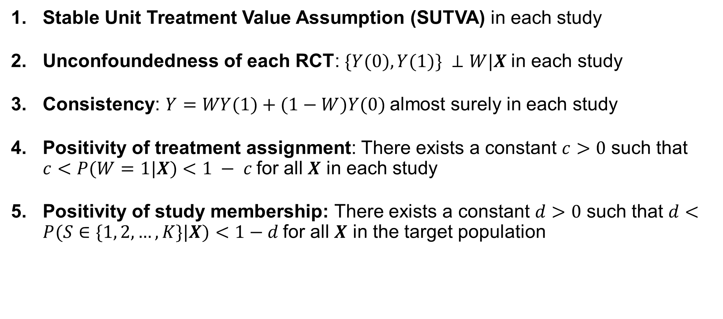
Assumptions
Stable Unit Treatment Value Assumption (SUTVA) in each study
Unconfoundedness of each RCT: $\{Y(0), Y(1)\} ⊥W|X$in each study
Consistency: $Y=WY(1)+(1−W)Y(0)$almost surely in each study
Positivity of treatment assignment: There exists a constant $c>0$ such that $c<P(W=1|X)<1 − c$for all $X$ in each study
Positivity of study membership: There exists a constant $d>0$ such that $d<P(S∈\{1, 2, …, K\}|X)<1−d$for all $X$ in the target population

Slide 9
Single-study methods
S-Learner
Causal Forest
Aggregation methods
No Pooling
Pooling with Trial Indicator
Ensemble Forest

